Slide 1

The Maker
Watch Guide and Discussion Questions.

Slide 2
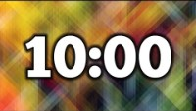
Quick Write – How important are Friends & Family?
Consider the people in your life. How important are they? How would your life be different without them?
You will write for ten minutes in your journal.

Slide 3

The maker

Slide 4

What do you Think?

Slide 5
What is the author trying to say?
Complete this chart under your quick write.
What’s happening?
What’s the significance?
Notes:
Have students break into groups and do this sheet. The goal is for them to find actions within the short that can link to a symbol.

Slide 6
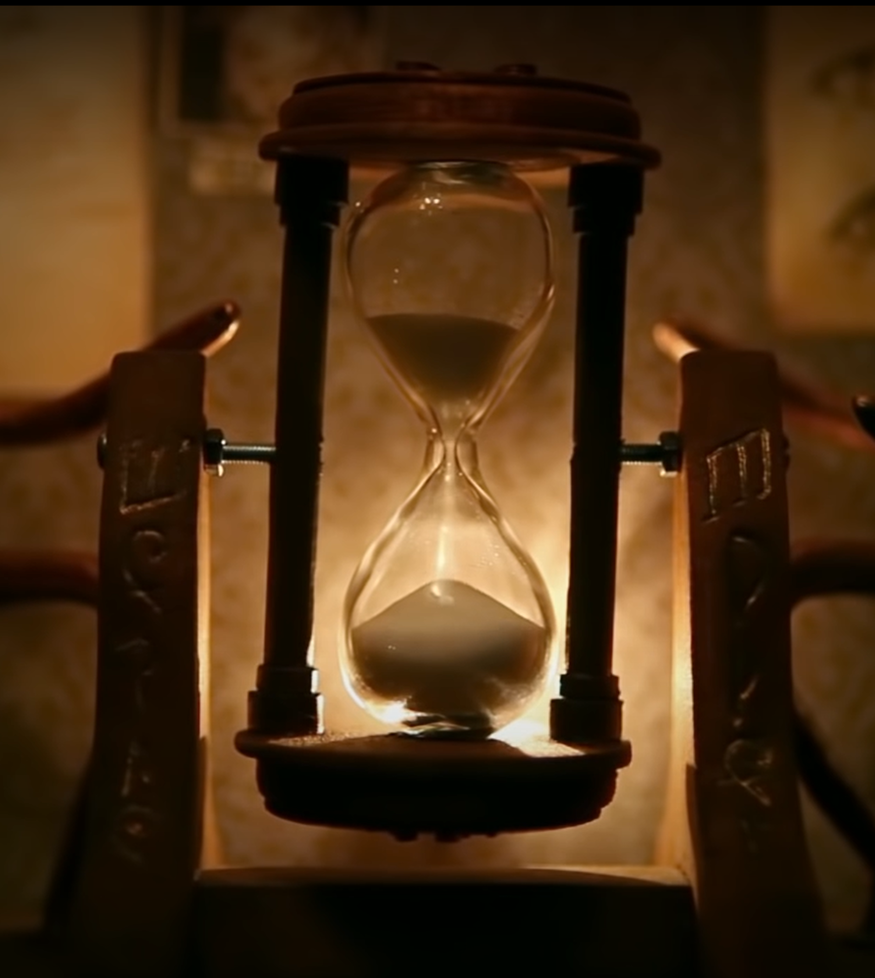
Symbolism
When an object within the text represents an abstract concept or idea.
Think about the video. What does the sand timer represent?
Think deeper – what could this represent in the bigger world?
Notes:
Be sure to explain what abstract means!! I suggest annotating right on the screen.
In the video, it represents the amount of time the bunny has left to bring his friend to life.
In the real world, it could represent the fleeting time we have to accomplish what we need to accomplish.

Slide 7
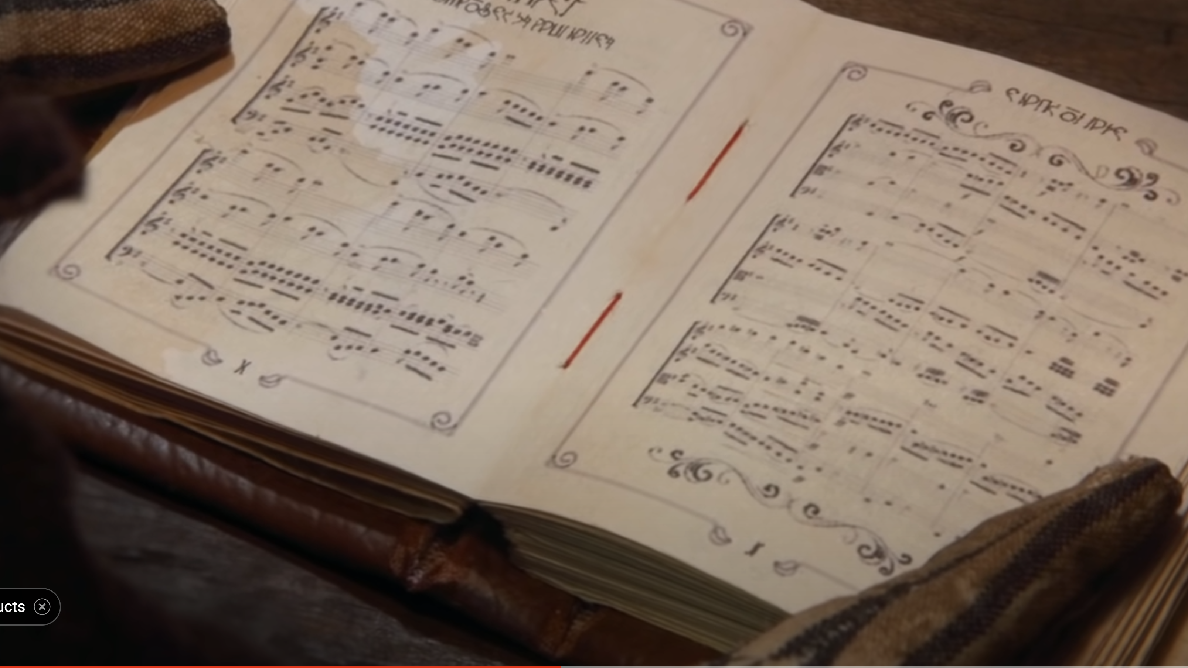
Symbols
A symbol is the object that leads to symbolism. The timer represents passing time in the video. Which then represents fleeting time in life.
We are going to watch the video again. On the page in your journal facing your quick write, identify at least two more symbols from “The Maker.” Take as many quick notes about that symbol as possible. You will use this later.
Notes:
Be sure to explain what abstract means!! I suggest annotating right on the screen.
In the video, it represents the amount of time the bunny has left to bring his friend to life.
In the real world, it could represent the fleeting time we have to accomplish what we need to accomplish.

Slide 8
The maker
Notes:
HINT – look at the clock. If you are running out of time, you may want to watch it the second time on 1.5 speed!

Slide 9
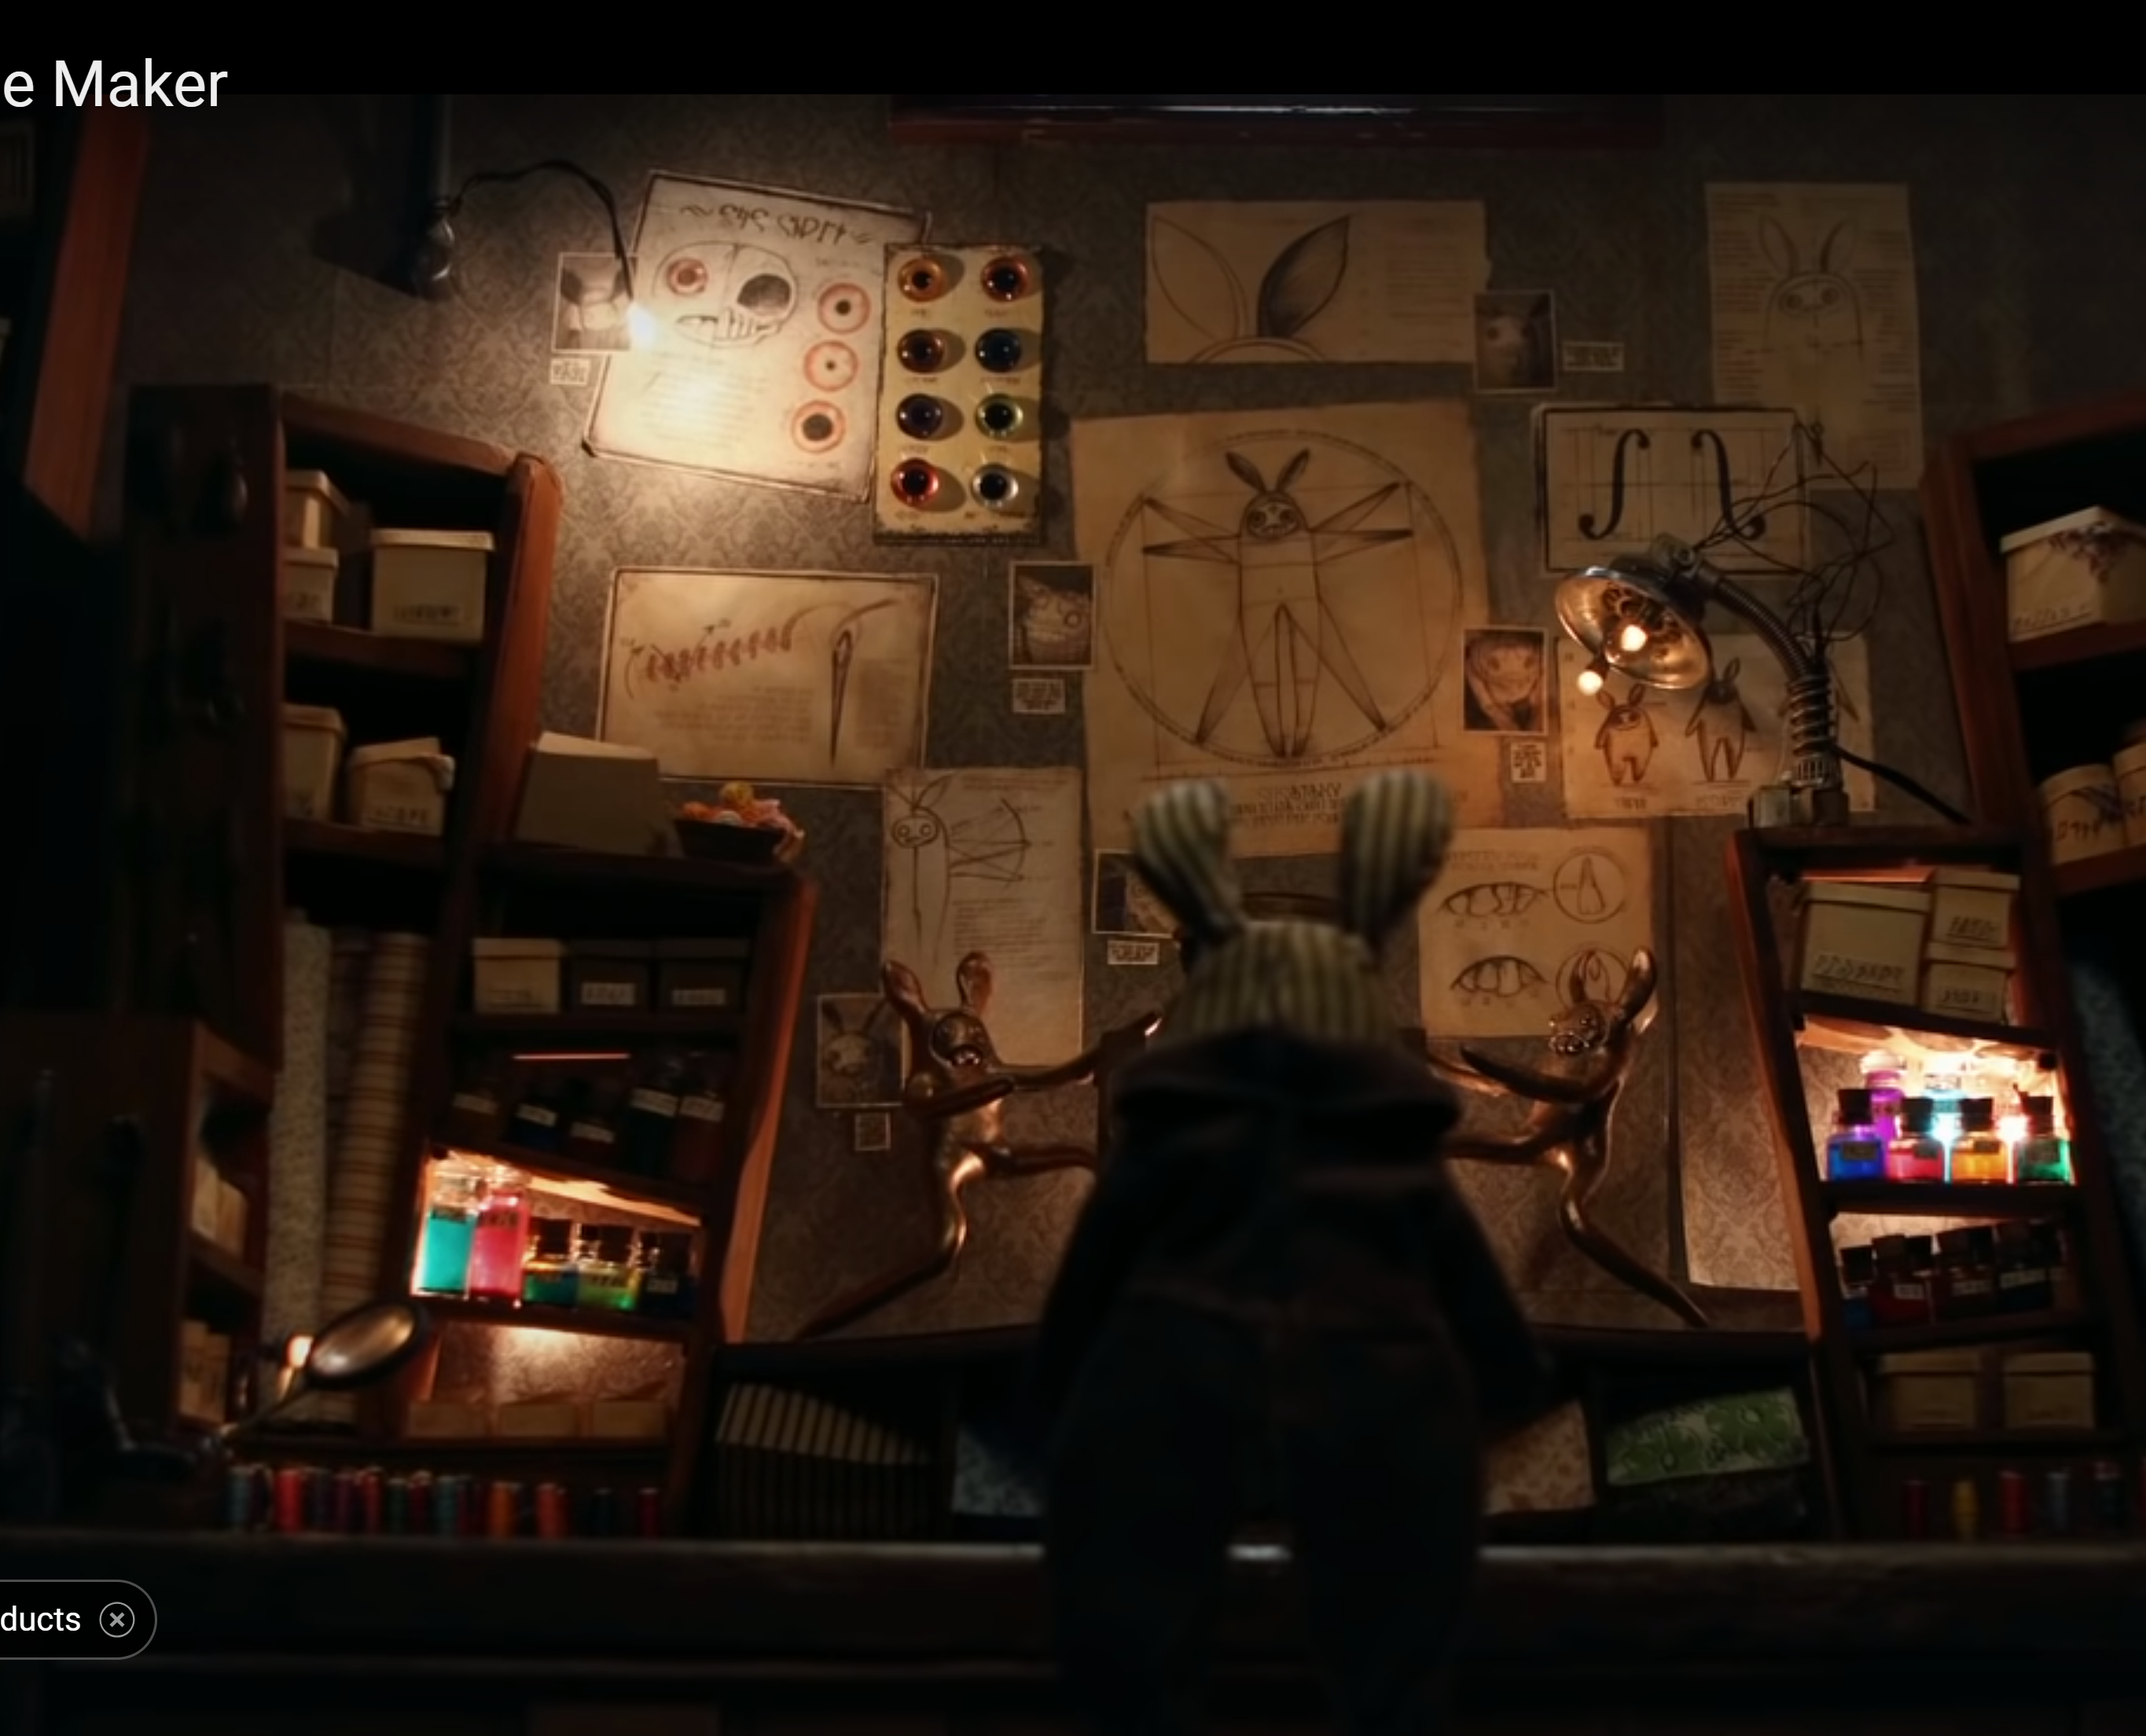
Symbols
First – What did you find?
Second – Find a new group. Now, you are going to take the symbols you found and your mixture of charts from earlier and see if you can figure out what the author’s message/theme is.

Slide 10
So what’s the author trying to say?
Remember a theme is similar to a teachable message. Thematic Concept is the one word subject in the text.
So, the question is…
How does symbolism reinforce that theme? Let’s look at the facts.
  a bunny is racing a sand timer to make a friend
  when the timer runs out the first bunny evaporates
  everything resets leaving the second bunny alone
  What is the purpose of the timer? How does it reinforce our theme?
Notes:
For this slide, the theme is “Life is short. Spend your time wisely.” or as the movie poster says “Life is what you make it.”

Slide 11
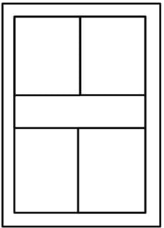
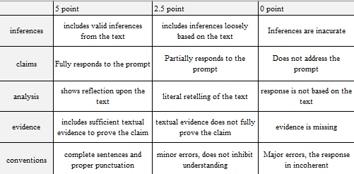





Your Job – choose a thematic concept and a theme that you believe this author is trying to create. Next – find two symbols that reinforce this theme. Last – Create a One-Pager! Don’t forget to explain yourself.
**explanations will be graded using the rubric.
Notes:
One pager Templates: https://www.teacherspayteachers.com/Product/One-Pager-Template-FREE-7111113
**For honors classes – I give the students their requirements for the one pager and a blank sheet of paper.

